Slide 1

Database Systems: Design, Implementation, and Management
Eighth Edition
Chapter 4
Entity Relationship (ER) Modeling

Slide 2
Objectives
In this chapter, you will learn:
  The main characteristics of entity relationship components
  How relationships between entities are defined, refined, and incorporated into the database design process
  How ERD components affect database design and implementation
  That real-world database design often requires the reconciliation of conflicting goals
Database Systems, 8th Edition

Slide 3
The Entity Relationship (ER) Model
ER model forms the basis of an ER diagram
ERD represents conceptual database as viewed by end user
ERDs depict database’s main components:
  Entities
  Attributes
  Relationships
Database Systems, 8th Edition

Slide 4
Entities
Refers to entity set and not to single entity occurrence
Corresponds to table and not to row in relational environment
In Chen and Crow’s Foot models, entity represented by rectangle with entity’s name
Entity name, a noun, written in capital letters
Database Systems, 8th Edition

Slide 5
Attributes
Characteristics of entities
Chen notation: attributes represented by ovals connected to entity rectangle with a line
  Each oval contains the name of attribute it represents
Crow’s Foot notation: attributes written in attribute box below entity rectangle
Database Systems, 8th Edition

Slide 6
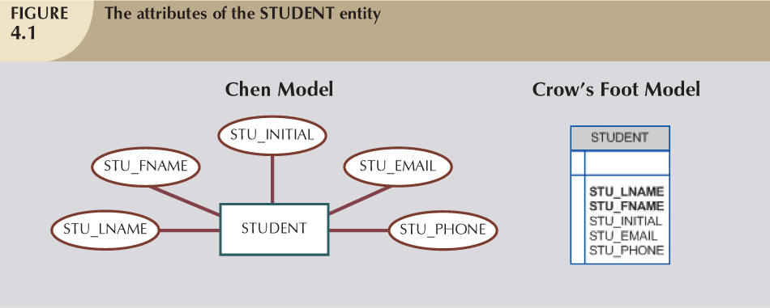
Database Systems, 8th Edition

Slide 7
Attributes (continued)
Required attribute: must have a value
Optional attribute: may be left empty
Domain: set of possible values for an attribute
  Attributes may share a domain
Identifiers: one or more attributes that uniquely identify each entity instance
Composite identifier: primary key composed of more than one attribute
Database Systems, 8th Edition

Slide 8
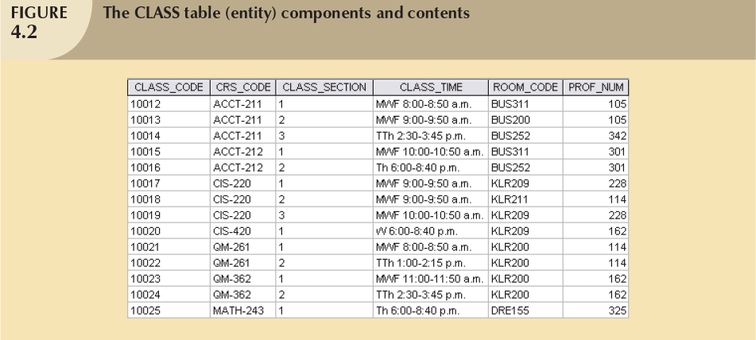
Database Systems, 8th Edition

Slide 9
Attributes (continued)
Composite attribute can be subdivided
Simple attribute cannot be subdivided
Single-value attribute can have only a single value
Multivalued attributes can have many values
Database Systems, 8th Edition

Slide 10
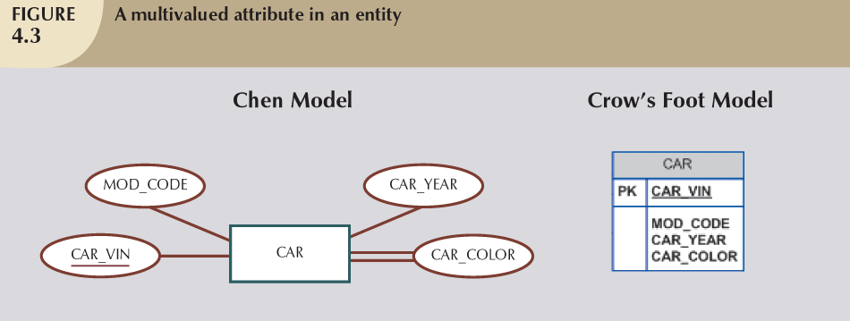
Database Systems, 8th Edition

Slide 11
Attributes (continued)
M:N relationships and multivalued attributes should not be implemented
  Create several new attributes for each of the original multivalued attributes components
  Create new entity composed of original multivalued attributes components
Derived attribute: value may be calculated from other attributes
  Need not be physically stored within database
Database Systems, 8th Edition

Slide 12
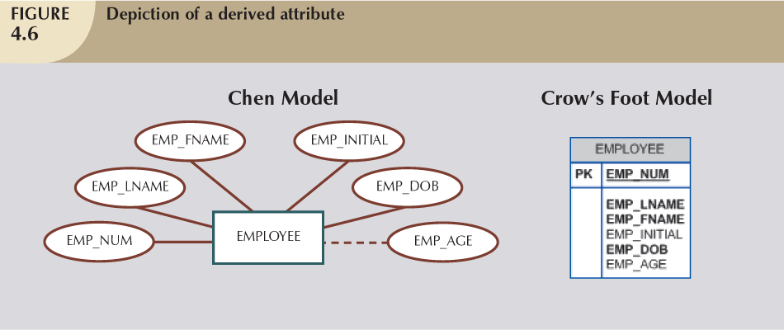
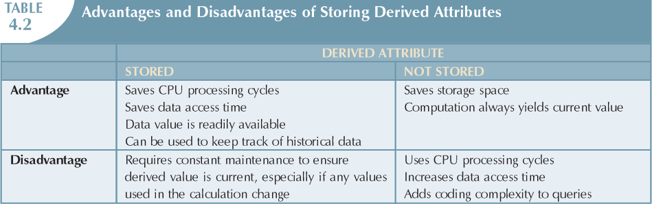
Database Systems, 8th Edition

Slide 13
Relationships
Association between entities
Participants are entities that participate in a relationship
Relationships between entities always operate in both directions
Relationship can be classified as 1:M
Relationship classification is difficult to establish if only one side of the relationship is known
Database Systems, 8th Edition

Slide 14
Connectivity and Cardinality
Connectivity
  Describes the relationship classification
Cardinality
  Expresses minimum and maximum number of entity occurrences associated with one occurrence of related entity
Established by very concise statements known as business rules
Database Systems, 8th Edition

Slide 15
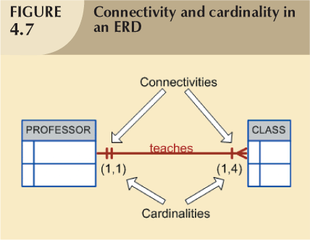
Database Systems, 8th Edition

Slide 16
Existence Dependence
Existence dependence
  Entity exists in database only when it is associated with another related entity occurrence
Existence independence
  Entity can exist apart from one or more related entities
  Sometimes such an entity is referred to as a strong or regular entity
Database Systems, 8th Edition

Slide 17
Relationship Strength
Weak (non-identifying) relationships
  Exists if PK of related entity does not contain PK component of parent entity
Strong (identifying) relationships
  Exists when PK of related entity contains PK component of parent entity
Database Systems, 8th Edition

Slide 18
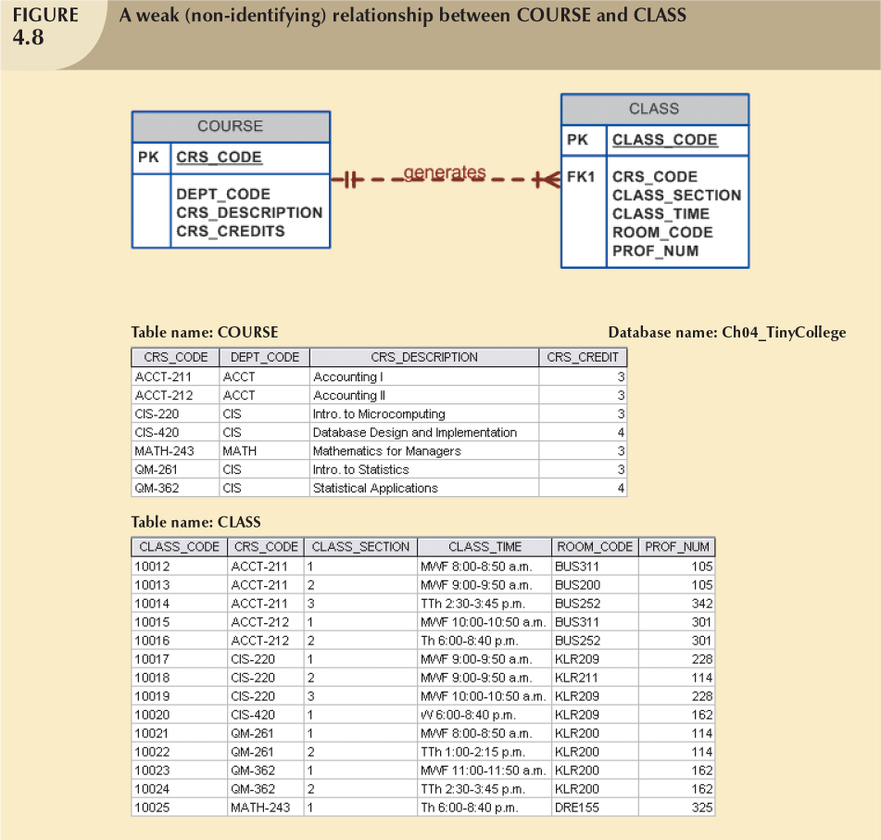
Database Systems, 8th Edition

Slide 19
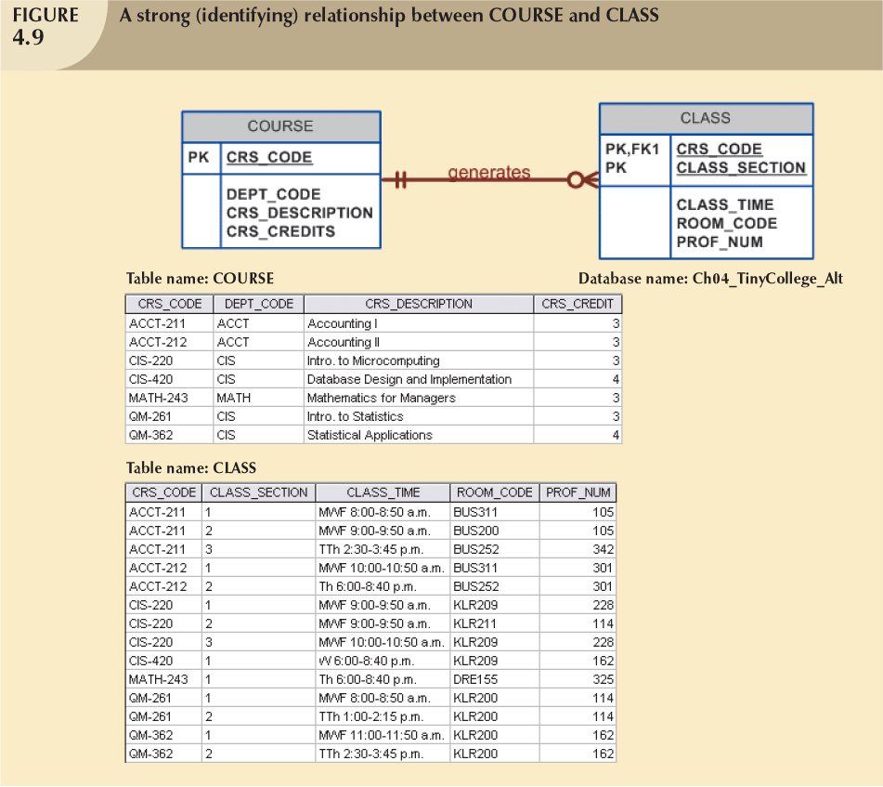
Database Systems, 8th Edition

Slide 20
Weak Entities
Weak entity meets two conditions
  Existence-dependent
  Primary key partially or totally derived from parent entity in relationship
Database designer determines whether an entity is weak based on business rules
Database Systems, 8th Edition

Slide 21
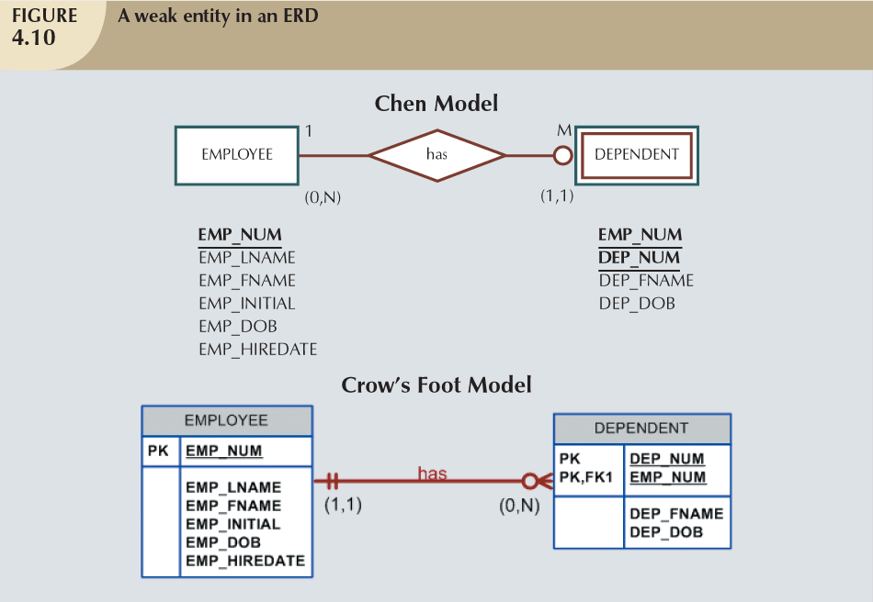
Database Systems, 8th Edition

Slide 22
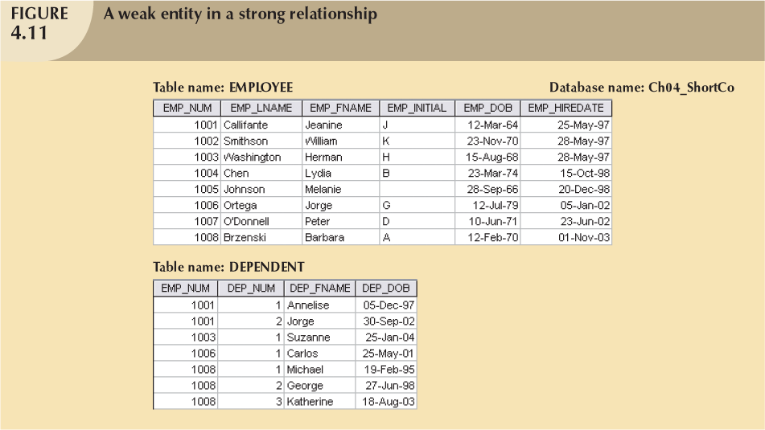
Database Systems, 8th Edition

Slide 23
Relationship Participation
Optional participation
  One entity occurrence does not require corresponding entity occurrence in particular relationship
Mandatory participation
  One entity occurrence requires corresponding entity occurrence in particular relationship
Database Systems, 8th Edition

Slide 24


Database Systems, 8th Edition

Slide 25
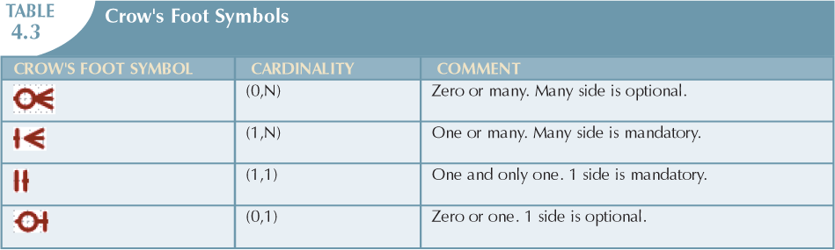
Database Systems, 8th Edition

Slide 26
Relationship Degree
Indicates number of entities or participants associated with a relationship
Unary relationship
  Association is maintained within single entity
Binary relationship
  Two entities are associated
Ternary relationship
  Three entities are associated
Database Systems, 8th Edition

Slide 27
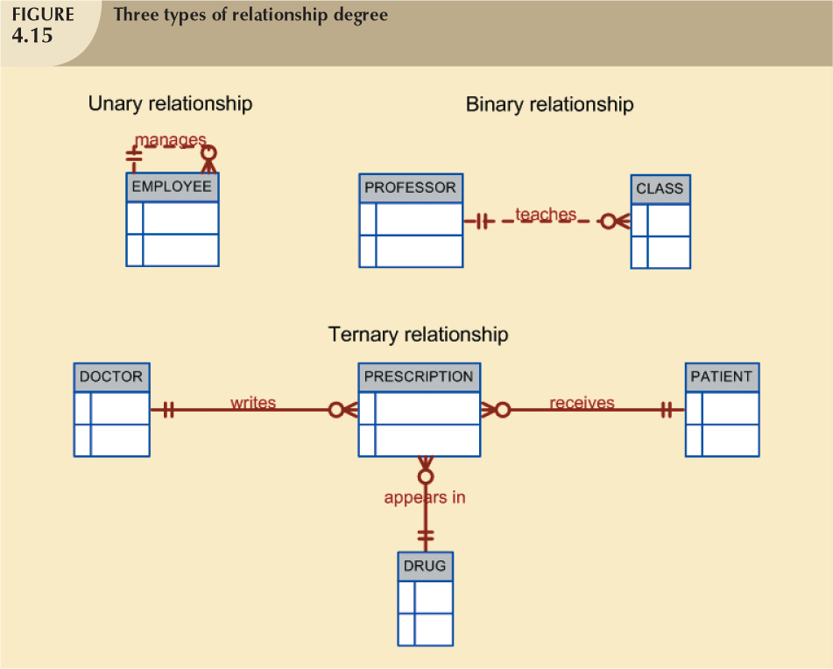
Database Systems, 8th Edition

Slide 28
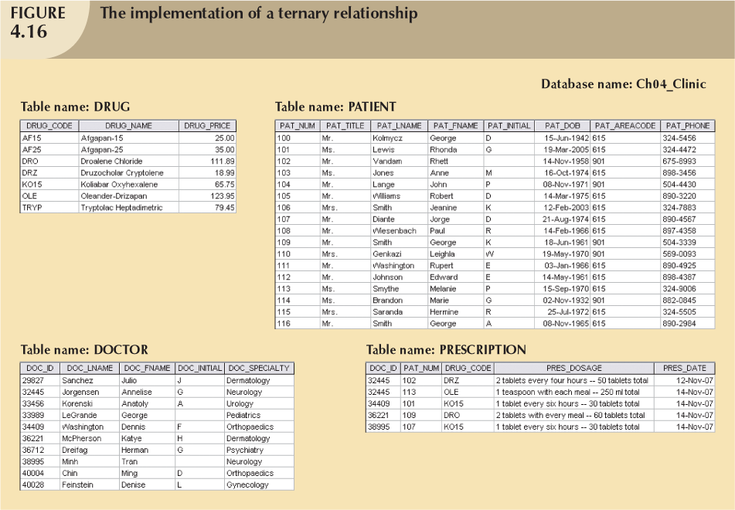
Database Systems, 8th Edition

Slide 29
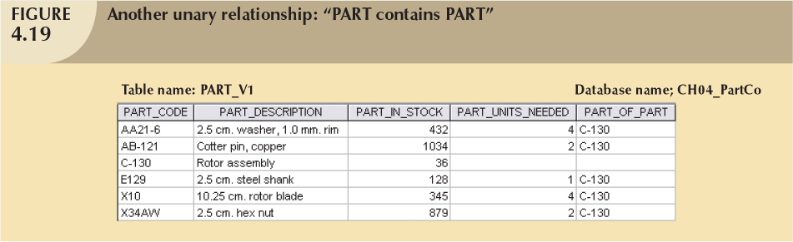
Recursive Relationships
Relationship can exist between occurrences of the same entity set
  Naturally found within unary relationship
Database Systems, 8th Edition

Slide 30
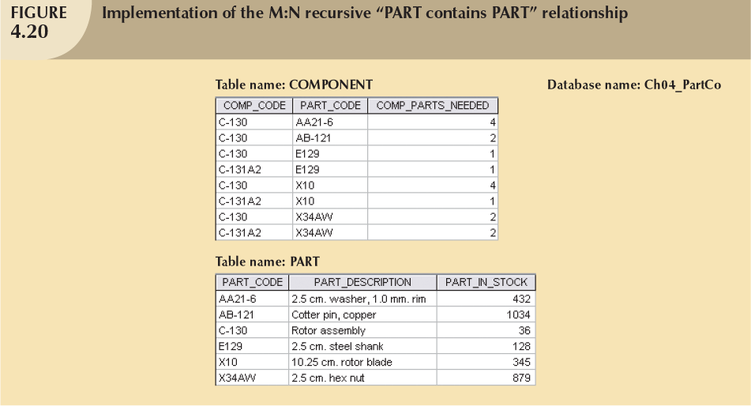
Database Systems, 8th Edition

Slide 31
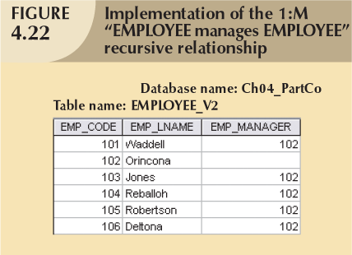
Database Systems, 8th Edition

Slide 32
Associative (Composite) Entities
Also known as bridge entities
Used to implement M:N relationships
Composed of primary keys of each of the entities to be connected
May also contain additional attributes that play no role in connective process
Database Systems, 8th Edition

Slide 33
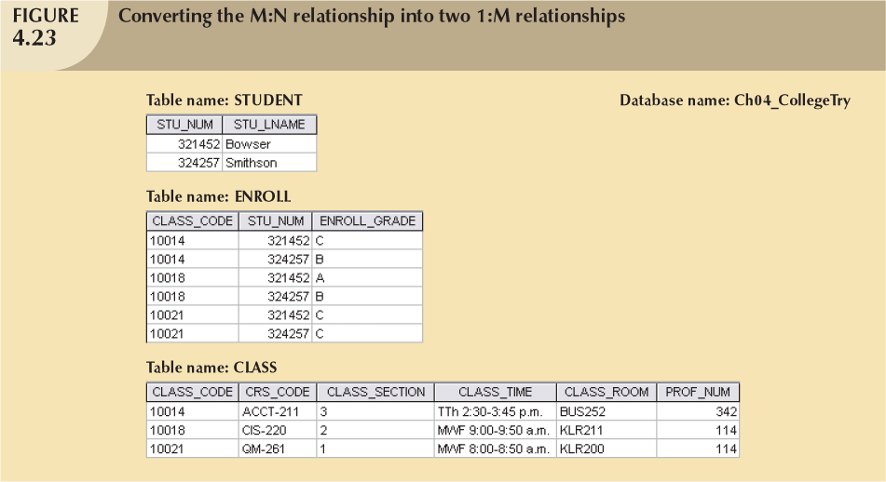
Database Systems, 8th Edition

Slide 34
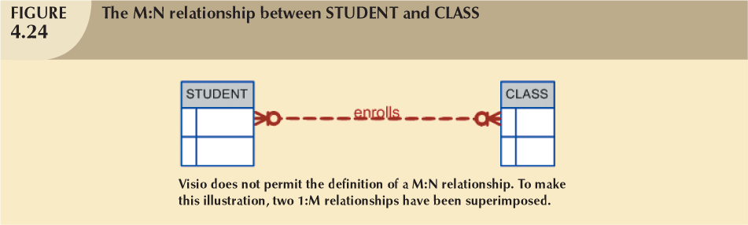
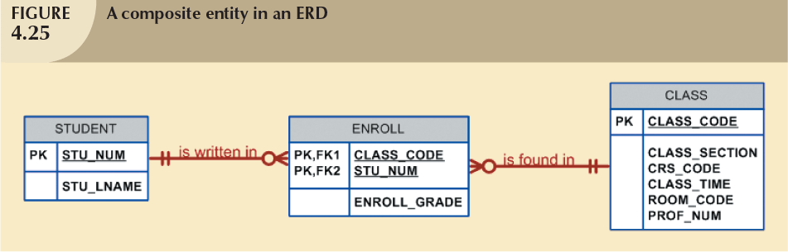
Database Systems, 8th Edition

Slide 35
Developing an ER Diagram
Database design is an iterative process
  Create detailed narrative of organization’s description of operations
  Identify business rules based on description of operations
  Identify main entities and relationships from business rules
  Develop initial ERD
  Identify attributes and primary keys that adequately describe entities
  Revise and review ERD
Database Systems, 8th Edition

Slide 36
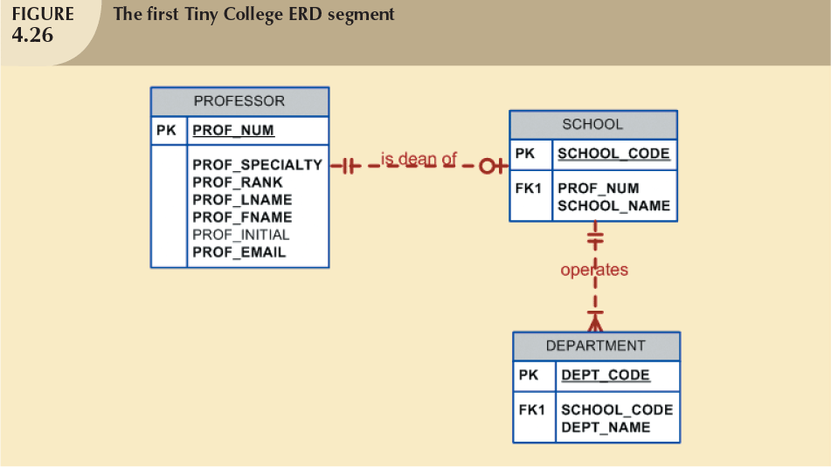
Database Systems, 8th Edition

Slide 37
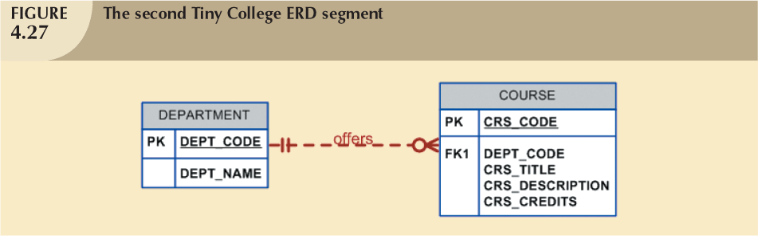
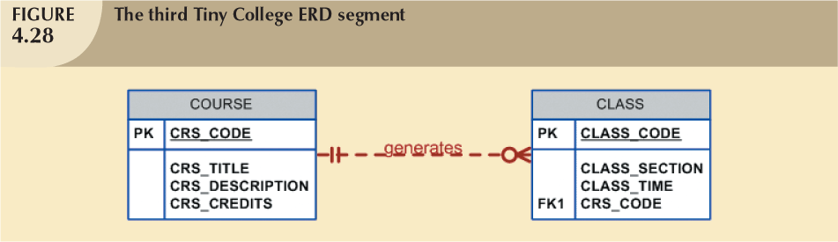
Database Systems, 8th Edition

Slide 38
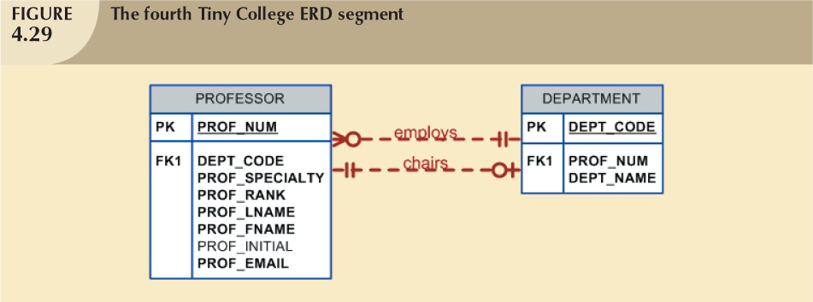
Database Systems, 8th Edition

Slide 39
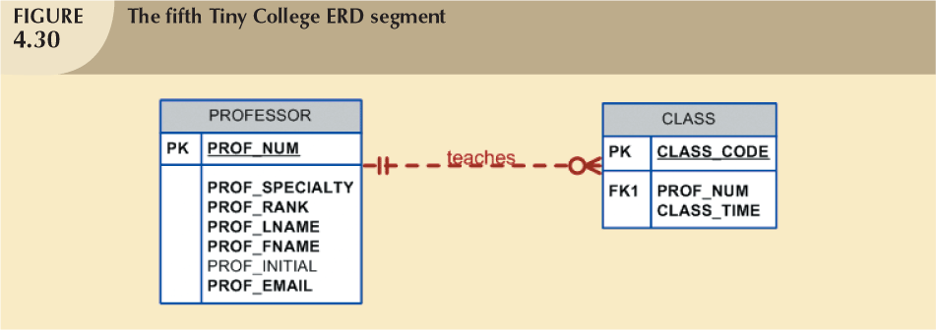
Database Systems, 8th Edition

Slide 40
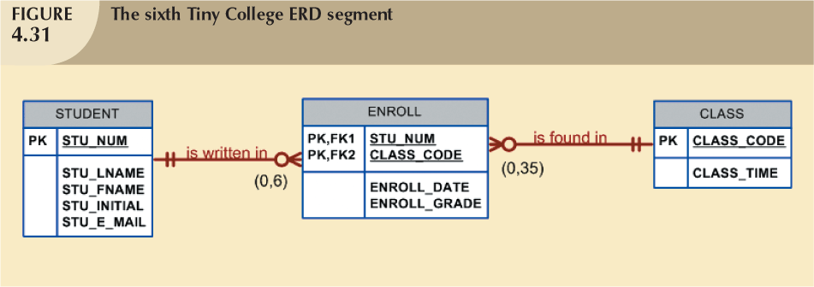
Database Systems, 8th Edition

Slide 41
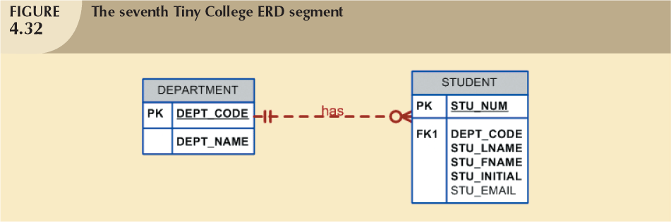
Database Systems, 8th Edition

Slide 42
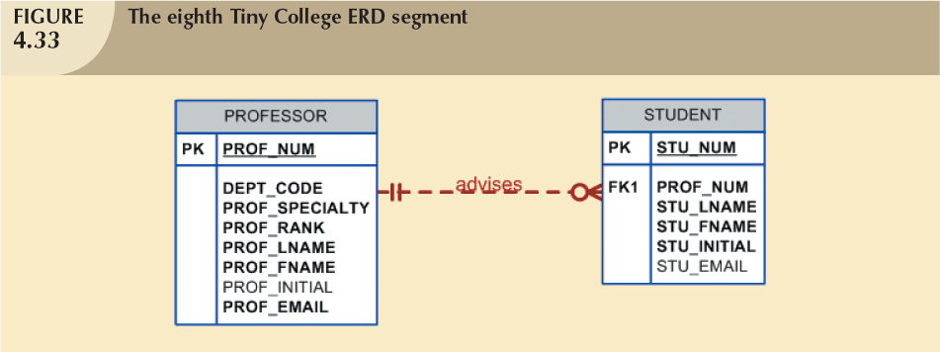
Database Systems, 8th Edition

Slide 43
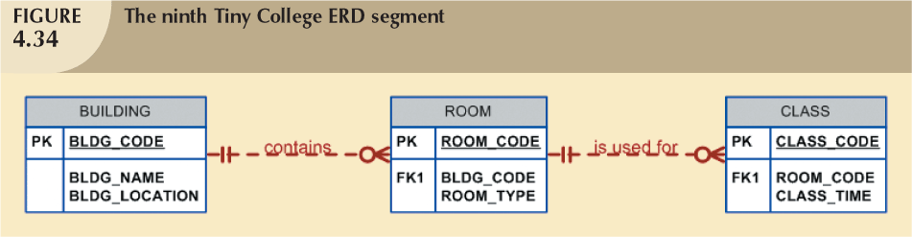
Database Systems, 8th Edition

Slide 44
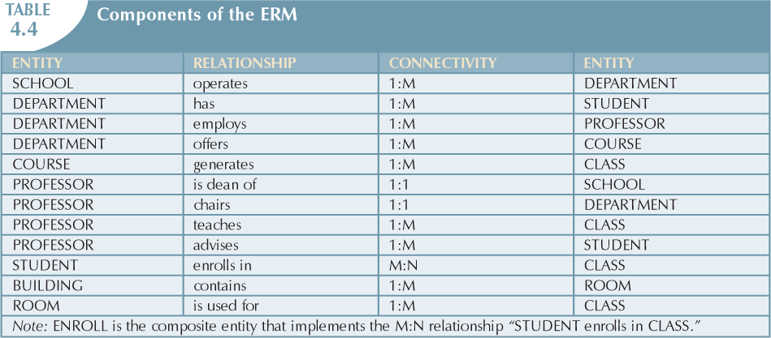
Database Systems, 8th Edition

Slide 45
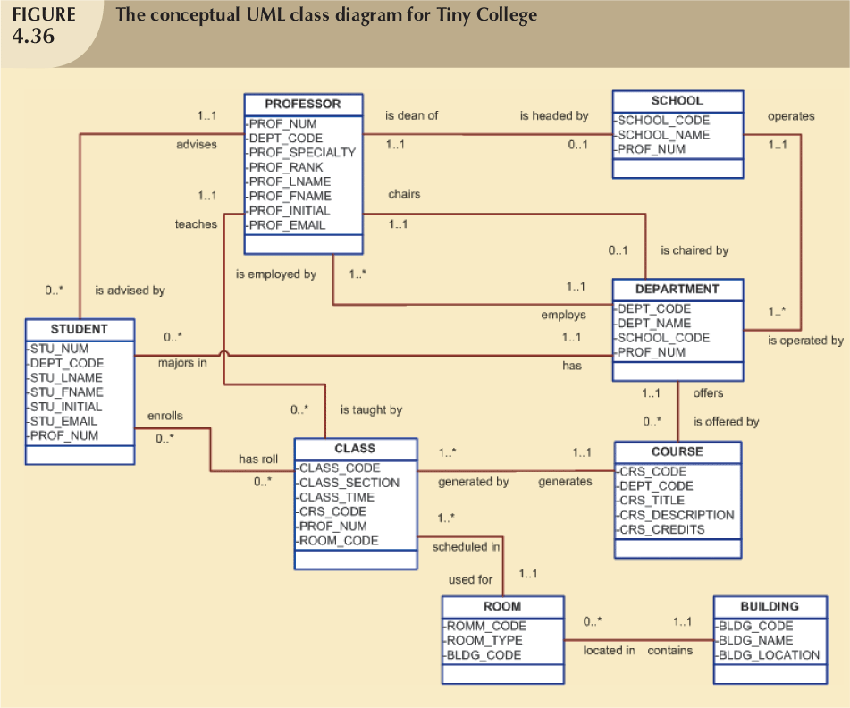
Database Systems, 8th Edition

Slide 46
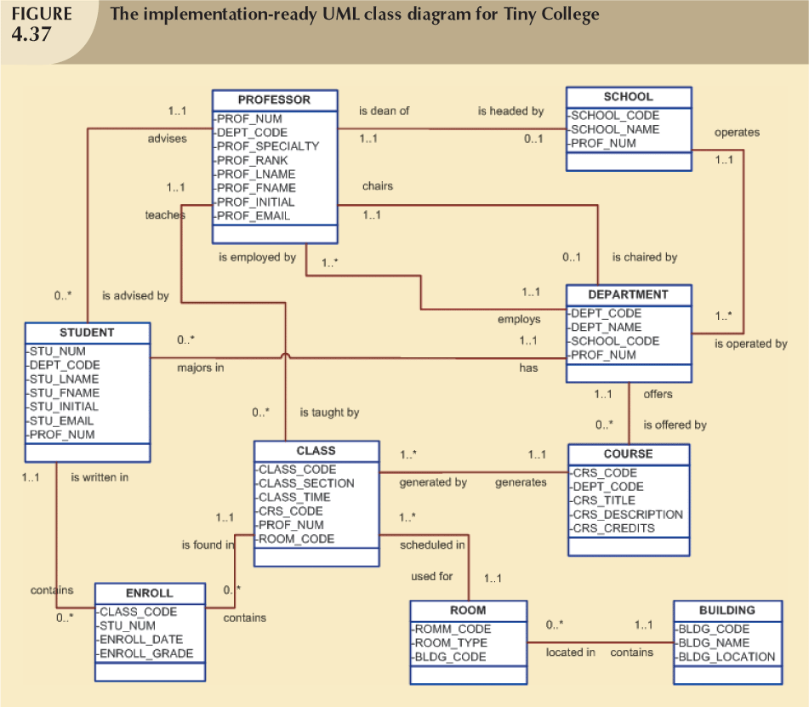
Database Systems, 8th Edition

Slide 47
Database Design Challenges:
Conflicting Goals
Database designers must make design compromises
  Conflicting goals: design standards, processing speed, information requirements
Important to meet logical requirements and design conventions
Design of little value unless it delivers all specified query and reporting requirements
Some design and implementation problems do not yield “clean” solutions
Database Systems, 8th Edition

Slide 48
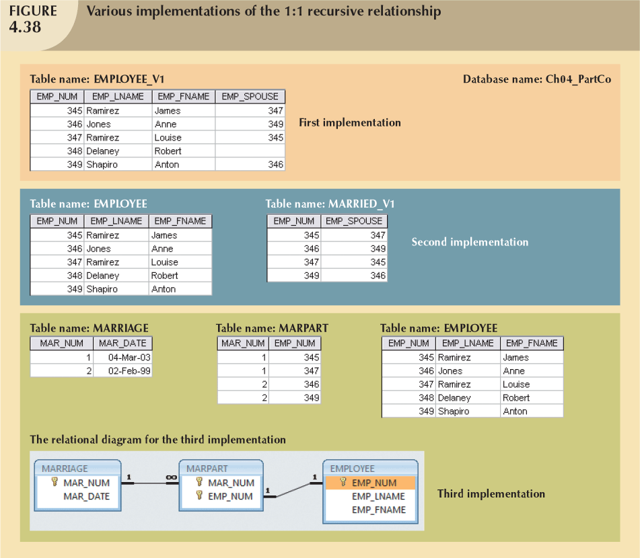
Database Systems, 8th Edition

Slide 49
Summary
Entity relationship (ER) model
  Uses ERD to represent conceptual database as viewed by end user
  ERM’s main components:
    Entities
    Relationships
    Attributes
  Includes connectivity and cardinality notations
Database Systems, 8th Edition

Slide 50
Summary (continued)
Connectivities and cardinalities are based on business rules
M:N relationship is valid at conceptual level
  Must be mapped to a set of 1:M relationships
ERDs may be based on many different ERMs
Database designers are often forced to make design compromises
Database Systems, 8th Edition

